Slide 1

The introduction of Android
Speaker: Alex
Date: 2015/03/1X

Slide 2
Agenda
Environment setup
Create the first program: Hello World!
Structure of an App
Component Access
Demo
Activity
Life Cycle
Activity switch (Intent, putExtra)
Demo
[Function Demo]
Download image via Internet & Save to SD card & Display
FAQ

Slide 3
Environment setup(1/4)
Prerequisite :
IDE: Eclipse or Android Studio (recommended)
http://developer.android.com/sdk/index.html
JDK: Java Development Kit
http://www.oracle.com/technetwork/java/javase/downloads/jdk8-downloads-2133151.html
Android SDK Manager
Packed in the Android studio

Slide 4
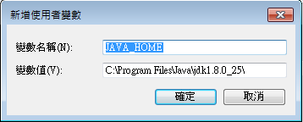
Environment setup(2/4)
Install IDE (Take Android Studio as example)
Just press “Next” to finish the installation.
Install Java Development Kit
Add environment variable
Variable name: JAVA_HOME
Value: the root folder of JDK

Slide 5
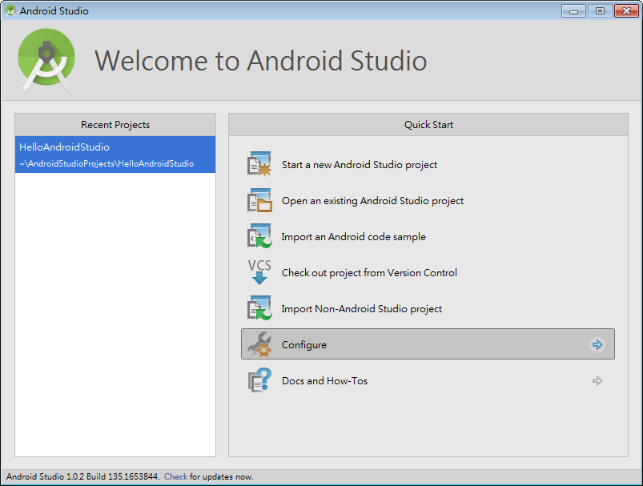
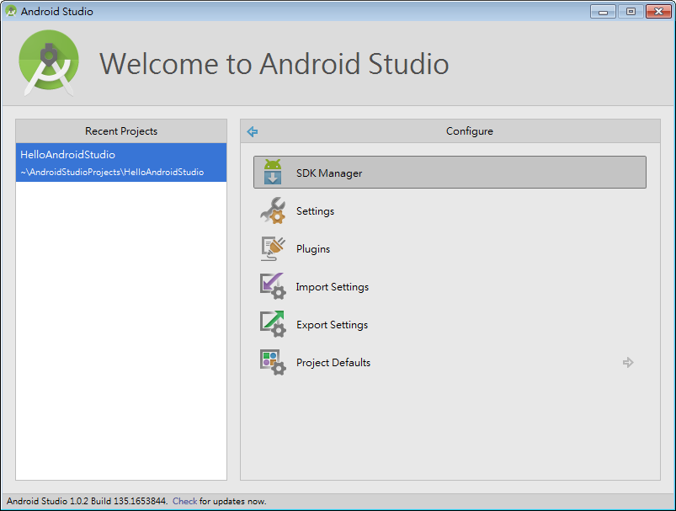
Environment setup(3/4)
Android SDK
Configure -> SDK Manager

Slide 6
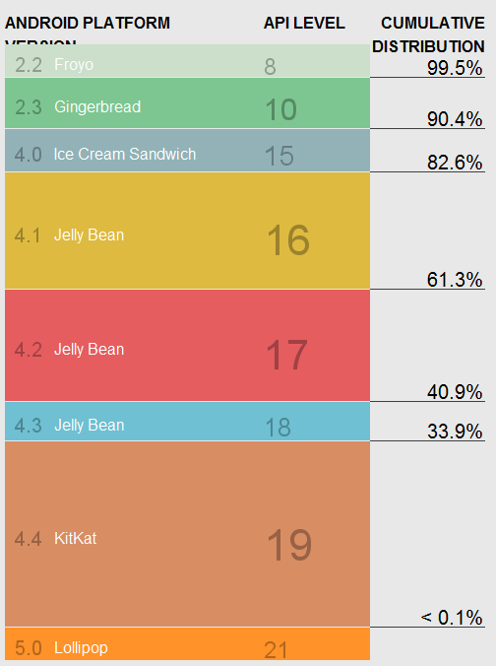

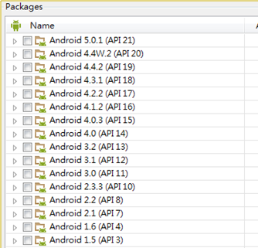
Environment setup(4/4)
Install SDK Tools & SDK Platform-tools
Install the Android API (4.0↑ recommended)

Slide 7
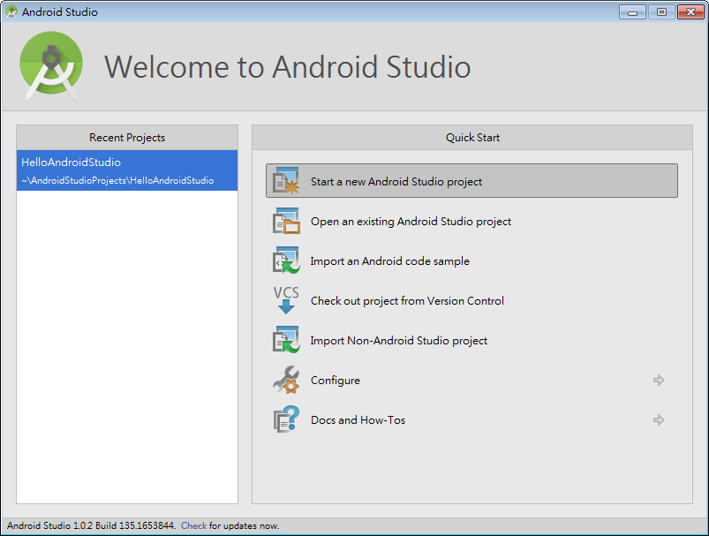
Create the first program

Slide 8
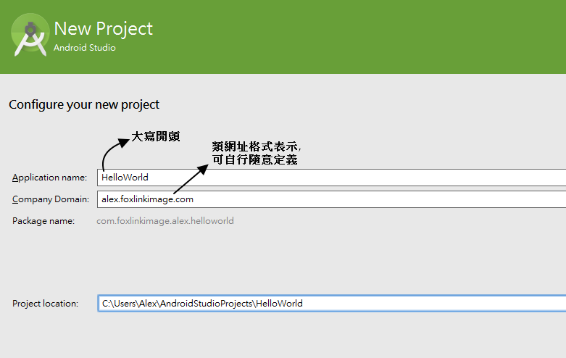
Create the first program

Slide 9
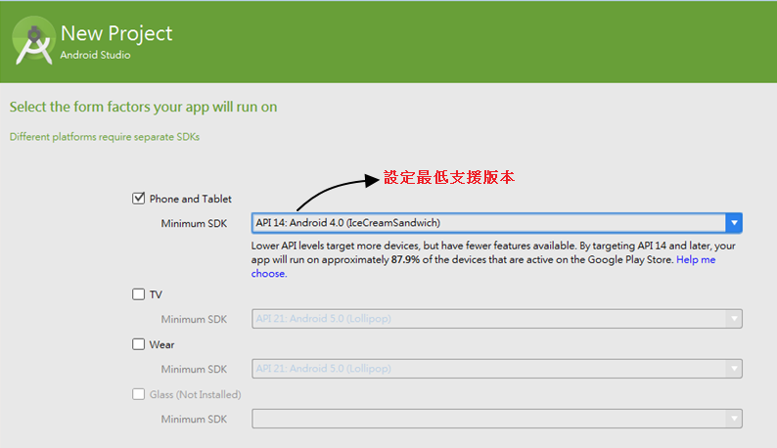
Create the first program

Slide 10
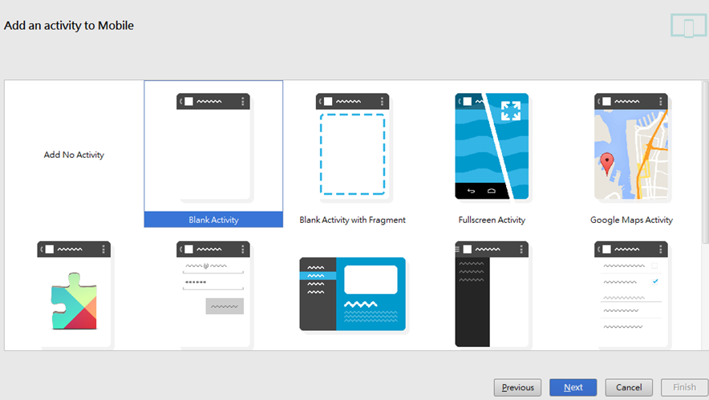
Create the first program

Slide 11
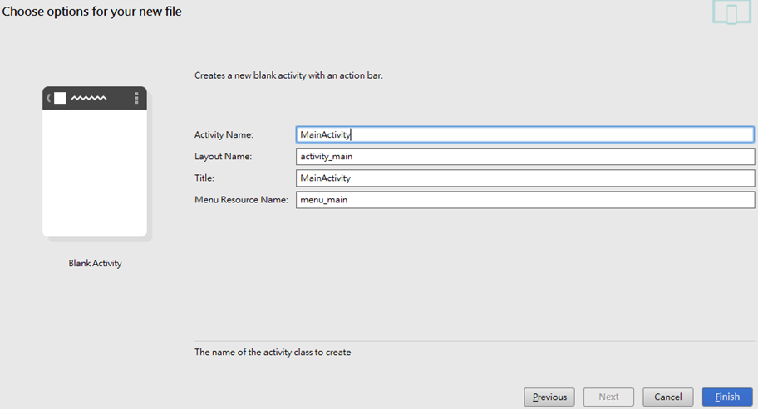
Create the first program

Slide 12
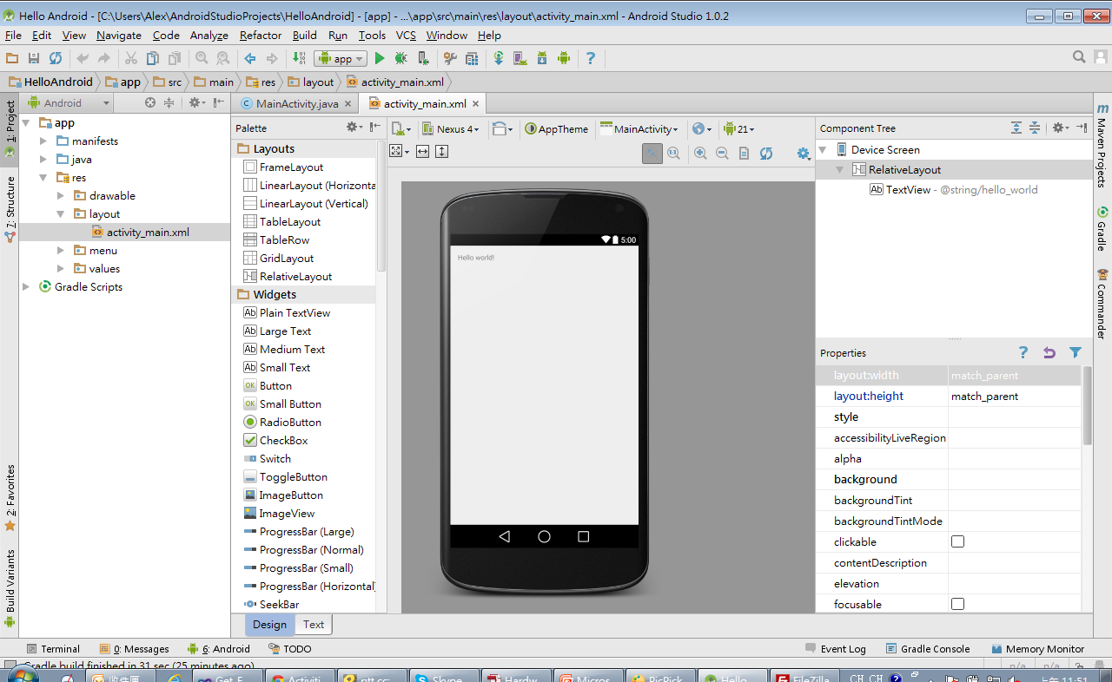
Create the first program

Slide 13
Create the first program
Run the program
Via AVD (Android Virtual Device)
Tool->Android->AVD Manager->Create Virtual Device
Flexible: You can setup the device on you own: Resolution, CPU architecture, RAM, SD Card, API…
Via your android mobile phone
Enable USB debugging. (Default is hidden)
Settings -> About Phone -> Build number
Tap 7 times to activate.
Settings -> Developer Options -> USB debugging

Slide 14
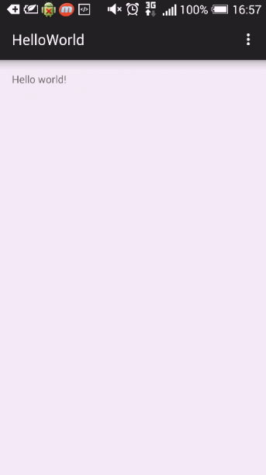
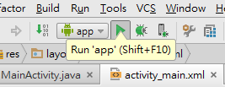
Press run button or Shift +F10 to run program

Slide 15
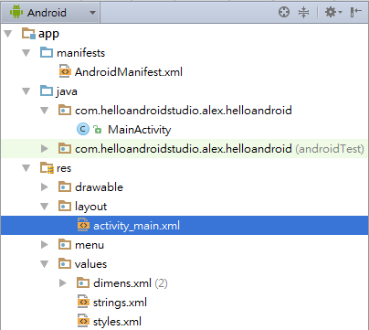
Structure
manifests – AndroidManifest.xml
Some information about this app (program entry point, permission, services…..)
java – MainActivity.java

Slide 16
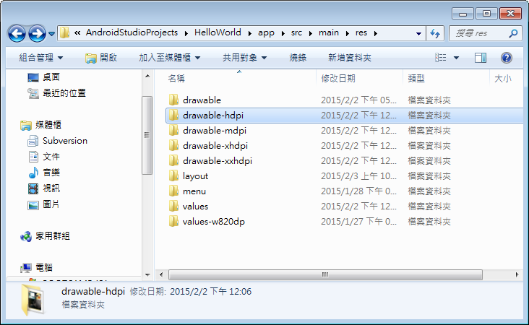
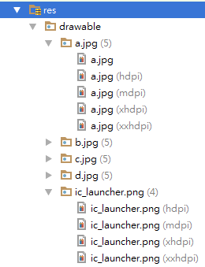
Structure
res - drawable
Bitmap, App Icon with different resolutions
Shape, Layer, Scale….

Slide 17
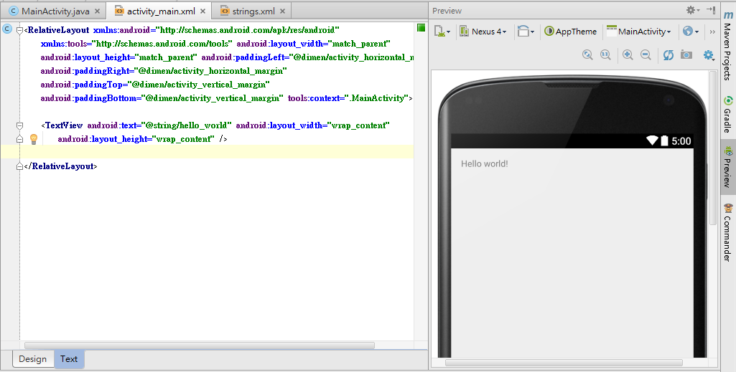
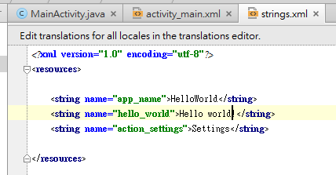
Structure
res - Layout

Slide 18
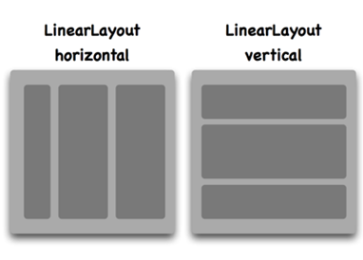
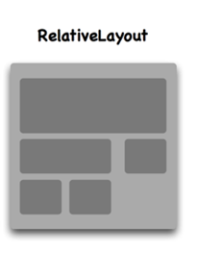
Structure
LinearLayout
android:orientation = “vertical”
android:orientation = “horizontal”
RelativeLayout
android:layout_above
android:layout_below
android:layout_toStartOf
android:layout_toEndOf
…
Others: FrameLayout, TableLayout, GridLayout

Slide 19
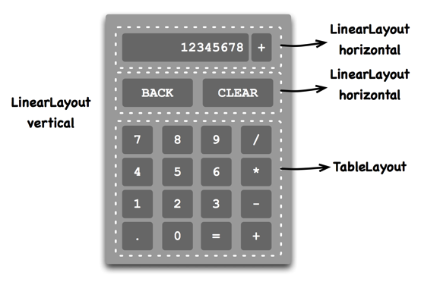
Structure
Also support nested form

Slide 20
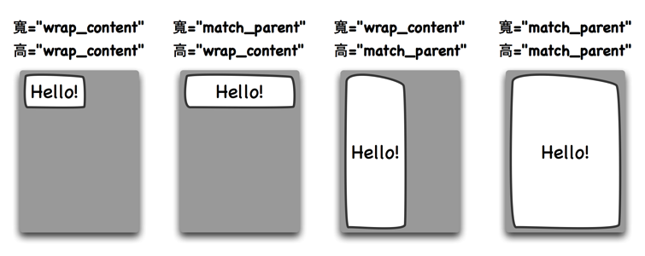
Structure
android:layout_width android:layout_height
Property can be set with:
Absolute value: e.g. 200px or 200dp (Do not hard-coded pixel ∵Different screen densities)
wrap_content
match_parent
Note: For android:textSize → uses “sp” instead

Slide 21
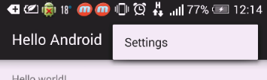
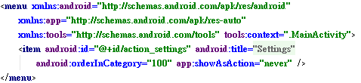
Structure
res - Menu

Slide 22
Structure
res - Values – strings
Multi-language

Slide 23

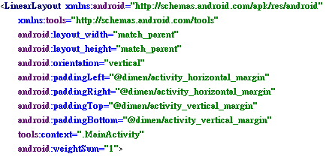
Structure
res - Values - dimens
dimens.xml
activity_main.xml

Slide 24
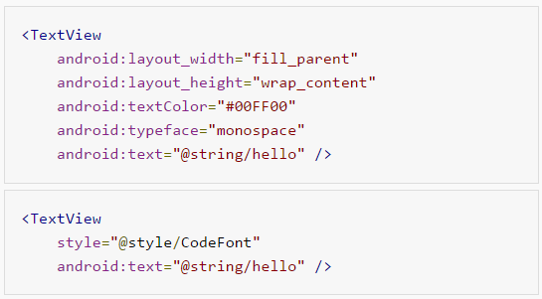
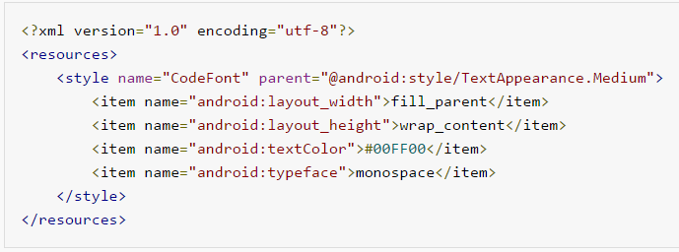
Structure
res - Values – styles
CSS-like
move
activity_main.xml
styles.xml

Slide 25
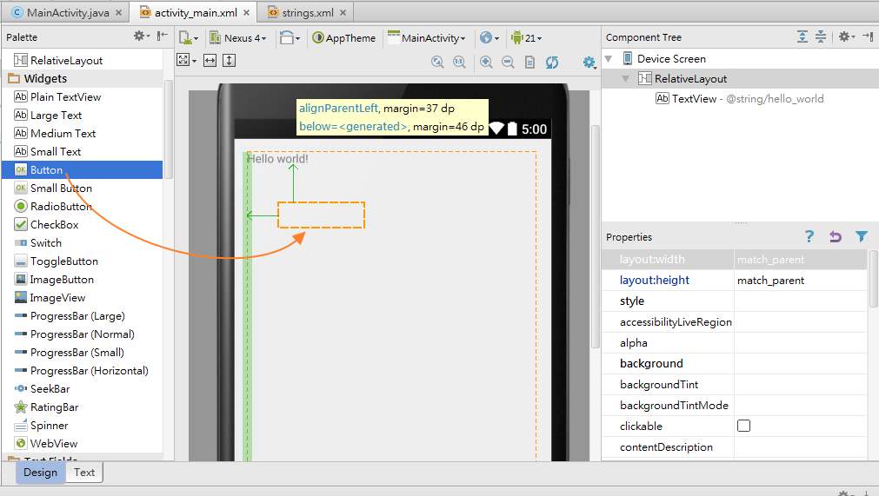
Component Access
Try to add a button to change “Hello world!”

Slide 26
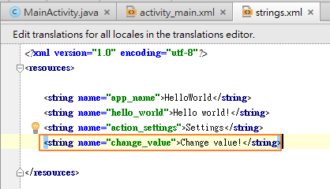
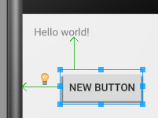
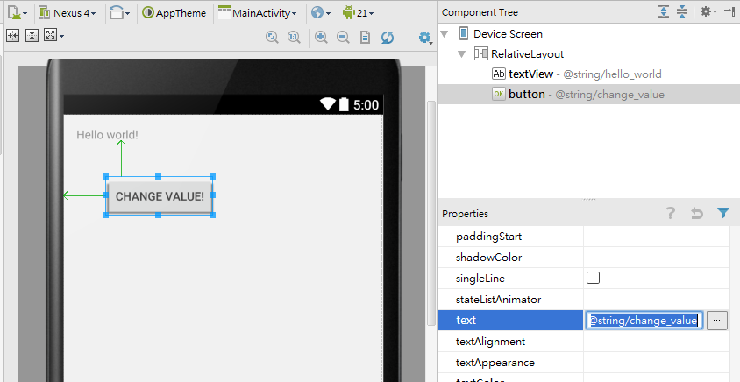
Add string into strings.xml
@string/KEY

Slide 27
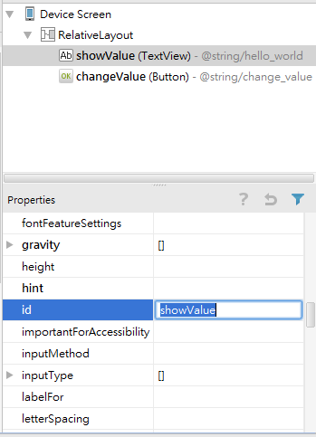
Set ID

Slide 28
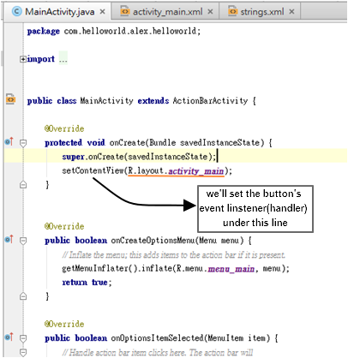
onCreate() --- Entry point of the program
Initializing
setContentView(R.layout.activity_main)

Slide 29
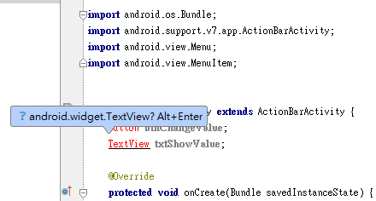
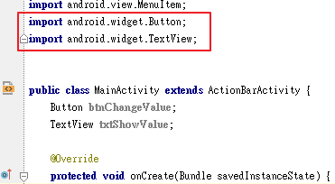
Component Access
To access component in the program.
Create instance of Button and TextView
Button btnChangeValue;
TextView txtShowValue;

Slide 30
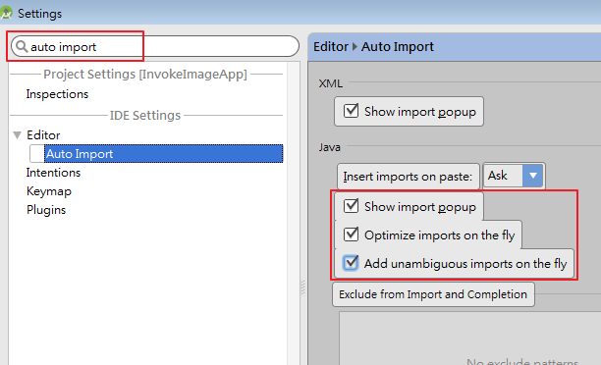
Component Access
(Hint) Auto import
File -> Settings or Ctrl+Alt+S

Slide 31
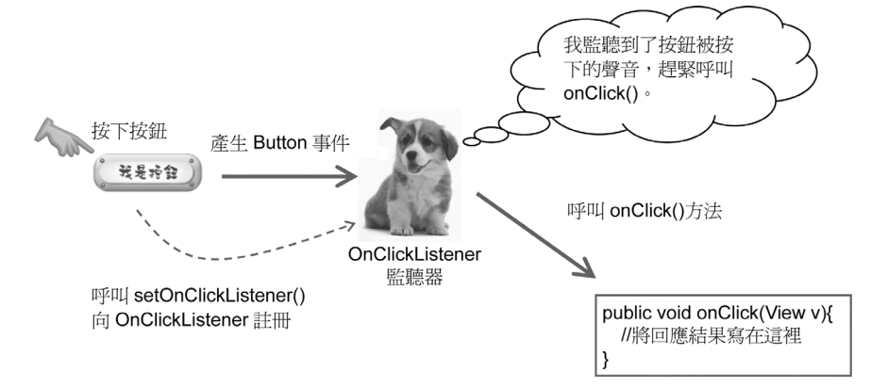
Component Access
Use method “findViewById(ID)”
btnChangeValue = (Button)findViewById(R.id.changeValue)
txtShowValue=(TextView)findViewById(R.id.showValue)
Click Listener

Slide 32
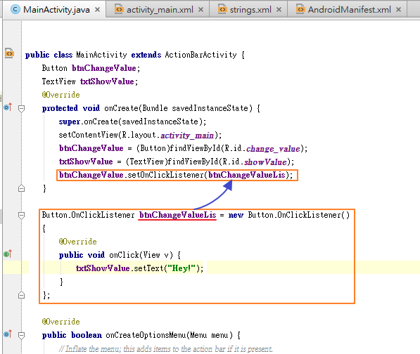
Register the Button’s event listener
Notes:
每一個View都可以註冊一個event listener，當Android框架收到「click」事件後，便回呼event listener的callback method。以Button類別（按鈕元件）為例，當我們想要處理使用者觸控按鈕的事件時，就要呼叫Button類別的setOnClickListener()方法來註冊click listener。

Slide 33
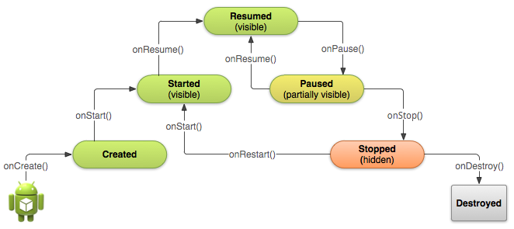
Activity Life Cycle

Slide 34
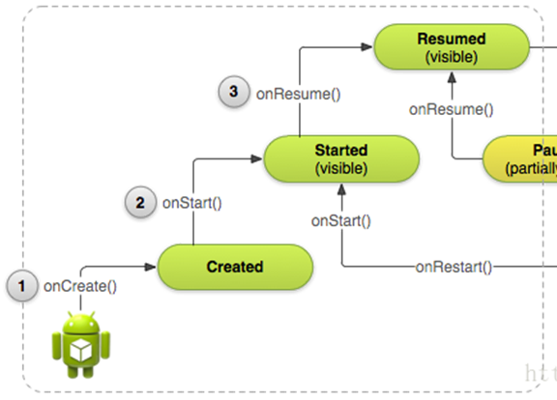
Activity Life Cycle

Slide 35
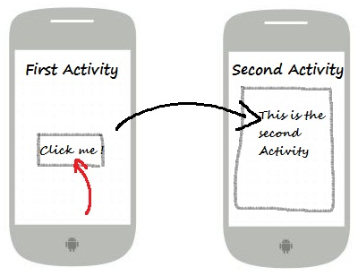
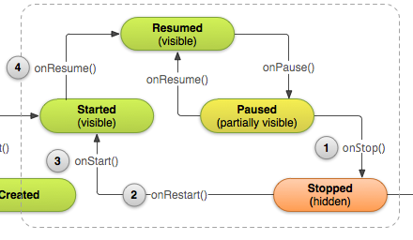

Activity Life Cycle
Press “Back” button

Slide 36
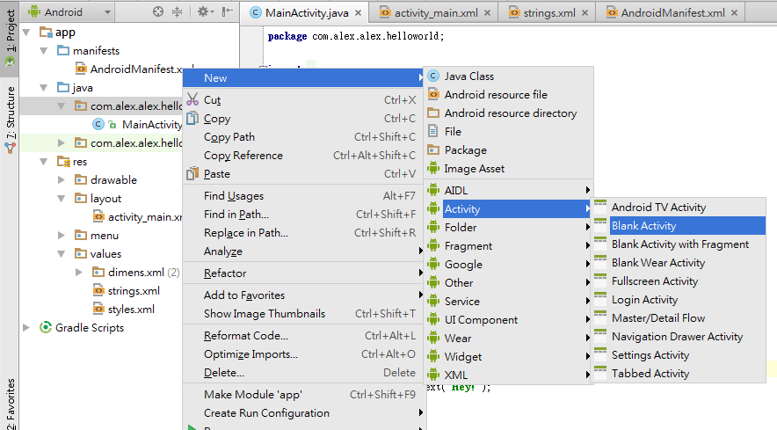
Activity
Create the second activity

Slide 37
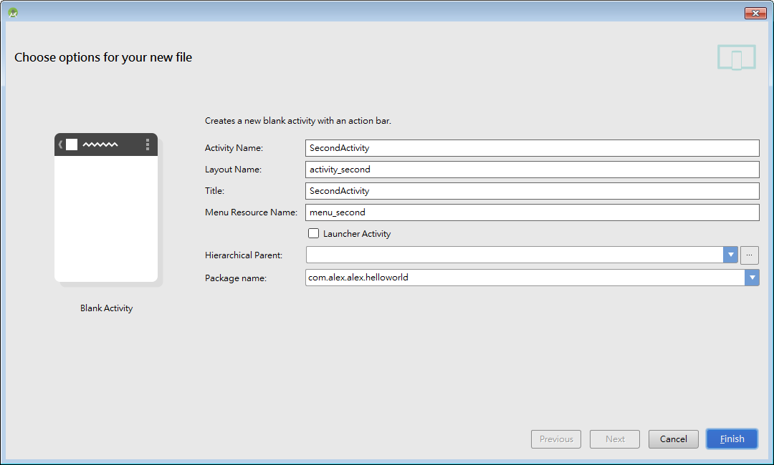
Activity

Slide 38


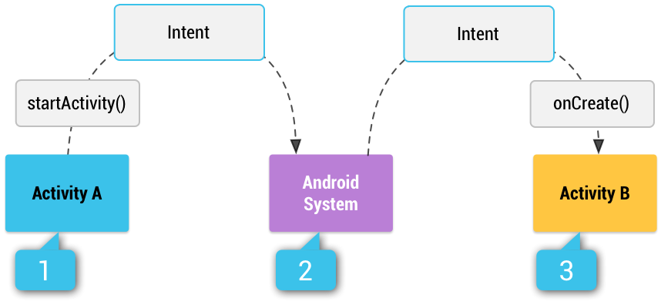
Activity
How to switch to another activity
Intent (意圖)
Explicit intent
Intent it = new Intent(MainActivity.this, SecondActivity.class);
StartActivity(it);
Implicit intent
Intent-filter
http://developer.android.com/training/basics/intents/sending.html

Slide 39
Activity
Can let Intent carry information to others.
MainActivity:
it.putExtra(“name”, “John”);
it.putExtra(“age”, 24);
SecondActivity:
String Name = getIntent().getStringExtra(“name”);
int Age = getIntent().getIntExtra(“age”);

Slide 40
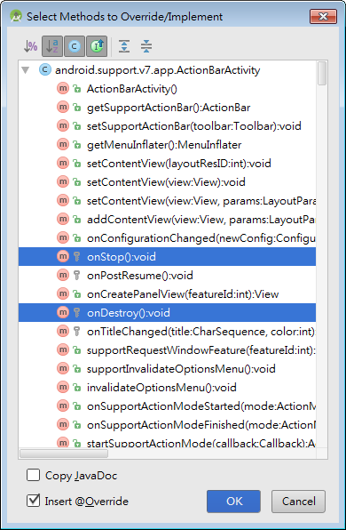
Activity
Press ctrl + O to override:
onStop()
onStart()
onRestart()
onPause()
onResume()
onDestroy()

Slide 41
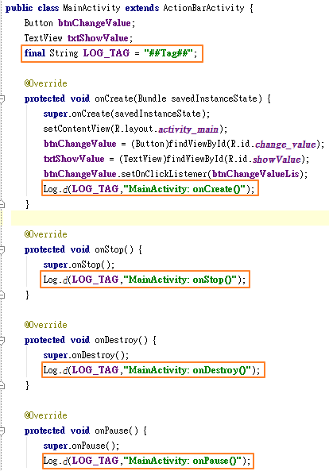
We use util.Log class to print the runtime message (like printf)
Declare a final String variable LOG_TAG = “##Tag##”
In each override method, add:
Log.d(LOG_TAG, ”Message”)
Use debug tool (DDMS) to get the message

Slide 42
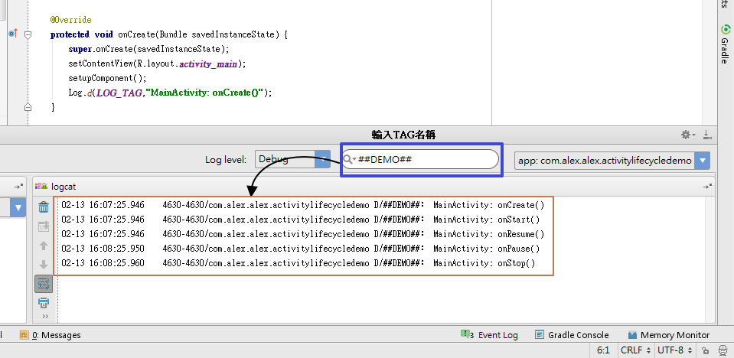
Activity

Slide 43
Activity
Activity life cycle demo

Slide 44
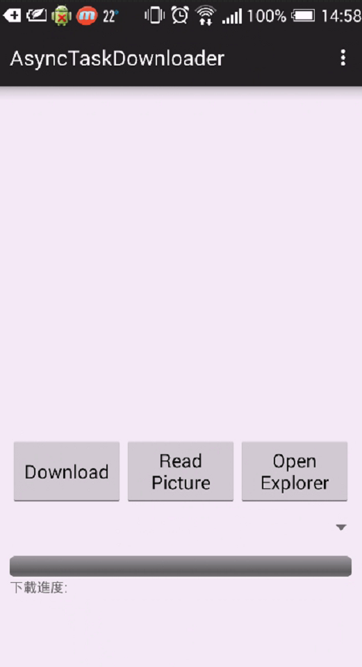
Function Demo

Slide 45
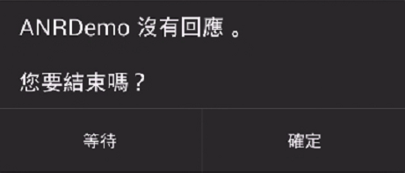
Function Demo
Main Thread (UI Thread)
Created when app starts.
ANR(Android is not responding) issue
Perform a time-consuming task. (e.g. Downloading, DB r/w)

Slide 46

Function Demo
Sub Thread (Worker Thread)
Can’t access UI component directly.
Handler
AsyncTask

Slide 47

Function Demo
Permission setting
AndroidManifest.xml

Slide 48
Service
Broadcast receiver
Content Provider

Slide 49
Reference
Android Developer - http://developer.android.com/develop/index.html
CodeData - http://www.codedata.com.tw/mobile/android-tutorial-the-2nd-class-2-ui/
Implicit activity -http://blog.csdn.net/xln0130/article/details/6721561
AsyncTask –http://developer.android.com/reference/android/os/AsyncTask.html

